Slide 1
Async Unit Testing
MSTest, NUnit, xUnit, Fixie
ThatConference, 2015 #AsyncTesting
Moq, FakeItEasy, nSubstitute, Typemock, RhinoMocks
Shouldly, Fluent Assertions
Notes:
Lightning talk from CodeMash 2012
Async Unit Testing has changed a *lot* from then till now!
Also parallels my son: Nov 2011 – Feb 2015

Slide 2



Slide 3
Who is this guy?

Slide 4
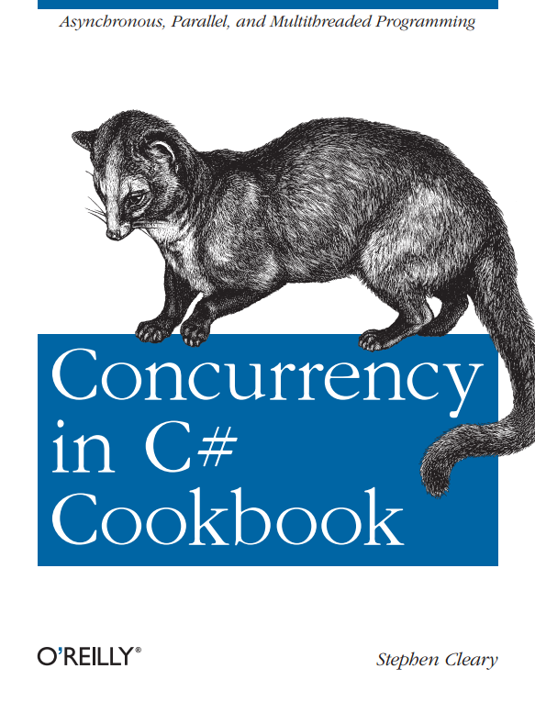

Slide 5
A(nother) Review of Async/Await

Slide 6
Introduction to Async
async Task DoNothingAsync()
{
// In the Real World, we would actually do something...
await Task.Delay(100);
}
The async keyword:
Enables the await keyword for that method.
Transforms the method into a state machine, very similar to the yield keyword.
That’s it!
Notes:
The async keyword can only be applied to a method.
Details of the transformation are not important; just be aware that there is a transformation going on.
No threads!

Slide 7
Introduction to Async
async Task DoNothingAsync()
{
// In the Real World, we would actually do something...
await Task.Delay(100);
}
async Task DoNothingAsync()
{
Task delay = Task.Delay(100);
await delay;
}
await
Takes a single argument.
“Awaitable”
Usually a Task or Task<T>.
Notes:
“Await” is like a unary operator; it takes a single argument (like a cast).
This argument is an “awaitable”. I won’t get into the specifics, but an “awaitable” is a type that matches a certain pattern (similar to how foreach works).
An “awaitable” represents an asynchronous operation. In this talk, all our “awaitables” are Task objects.
Technically, you don’t “await” a method; you call the method and then “await” the Task it returns. But “await a method” and “awaitable method” are common phrases.
- Another method can await the task returned from DoNothingAsync, not b/c the method is async, but b/c it returns a Task.
Async methods start synchronously; so this method will (synchronously) call Task.Delay and then await.
Await is where things can start to get asynchronous.

Slide 8
Introduction to Async
async Task DoNothingAsync()
{
// In the Real World, we would actually do something...
await Task.Delay(100);
}
await behavior:
If awaitable (task) is complete, continues synchronously.
Otherwise:
Pauses the method and registers it with the awaitable.
Then returns.
Notes:
The “registering” is saying, “when you complete, please resume this method”.
When DoNothingAsync returns, it returns an incomplete Task.
This Task is completed when the DoNothingAsync completes (end of method or “return” statement).

Slide 9
Introduction to Async
async Task<int> AddTwoAsync()
{
int data = await GetIntAsync();
return data + 2;
}
What the Task means:
Represents the execution of the method.
Contains the result of the method (including exceptions).
Notes:
The returned Task represents this method; when this method completes, it will complete the Task.
Await “unwraps” the Task and retrieves its result (or raises an exception).
If a method returns a value (return statement), then that value becomes the Task’s result.
If a method throws an exception, then that exception is placed on the Task.

Slide 10
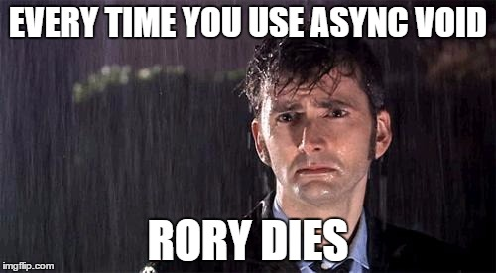
The Important Bits (for testing)
When testing an asynchronous (Task-returning) method, the important part to test is the Task that it returns.
This is one major reason to avoid async void.
The await operator has special behavior when the asynchronous operation is already complete.
Notes:
The returned Task represents the async method.
The async state machine uses that Task to report completion, results, and exceptions.
DEMO

Slide 11
TDD in two minutes*
* Not really. Just the part of TDD that is really important for async unit testing.

Slide 12

The Red/Green/Refactor cycle.
Why “Red”?
The Red part of the cycle tests the unit tests.
Notes:
At least, don’t skip the red until you’re used to async unit testing.

Slide 13
Demo: When you skip Red
Notes:
Can anyone tell me why the exception doesn’t fail the unit test?

Slide 14
Unit Testing Frameworks

Slide 15
Avoid Async Void Unit Test Methods
MSTest rejects them with warning UTA007.
NUnit supports them in 2.6.2+ and 2.9.6.
They’ve already removed this in 2.9.7.
(NUnit’s 2.9.x versions are the betas for 3.0)
xUnit added support in 2.0.0.
Fixie detects and fails them.
[TestMethod]
async void TestMethod()

Slide 16
Use Async Task Unit Test Methods
Any unit test framework less than 2-3 years old!
MSTest – Visual Studio 2012 (2012-08)
NUnit – 2.6.2 / 2.9.6 (2012-10)
xUnit – 1.9 (2012-01)
Fixie – 0.0.1.49 (2013-05)
[TestMethod]
async Task TestMethod()
Notes:
Xamarin (last I heard) is using an outdated version of NUnitLite, and does not support async unit tests at all.

Slide 17
Providing a SynchronizationContext
The big question for test frameworks.
Should either always be done or never be done.
MSTest – Never provides context (free-threaded).
xUnit – Always provides context (single-threaded context).
NUnit – Used to provide context “when necessary”.
Fixie – Never provides context (free-threaded).
Notes:
Beware of unexpectedly changing the test environment.
NUnit – undecided about next version.

Slide 18

Assertion Libraries: Delegate Fun!

Slide 19
Avoid Async Void Delegates!
Async lambdas passed as Action parameters become async void! Poor Rory!
Synchronous delegate with no return value:
void Method(); Action
Asynchronous delegate with no return value:
Task MethodAsync(); Func<Task>
Notes:
Anytime you have assertion library helper methods that take a delegate, those helper methods must be updated to also handle asynchronous overloads.
Blog post for other synchronous/asynchronous delegate equivalents.

Slide 20

Common Example: Assert.Throws
void Assert.Throws(Action);
WinStore: Assert.ThrowsException
xUnit: Assert.Throws
NUnit: Assert.Throws
Shouldly: Should.Throw
FA: sut.Invoking(…).ShouldThrow

Slide 21
Why Assert.Throws?
[ExpectedException] has existed for a long time.
[ExpectedException] only passes the unit test if the test method raises an exception.
Assert.Throws<TException>(() => testcode());
Notes:
ExpectedException only checks the test method as a whole.
Not good for more complex tests.
The better approach takes a delegate and executes it, observing exceptions.
ExpectedException does work for async unit tests (MSTest & NUnit).

Slide 22
Async Assert.Throws
void Assert.Throws(Action);
Task Assert.ThrowsAsync(Func<Task>);
Support:
MSTest – Assert.ThrowsException (only for WinStore unit test projects)
xUnit – Assert.ThrowsAsync (in 2.0.0)
NUnit – not currently supported (not in v2.9.x yet, either)
Shouldly – Should.Throw
FA – ☹ implements sut.Awaiting(…).ShouldThrow<T>() with a call to Task.Wait().
Will deadlock if you (or unit test framework) provides a context.
Notes:
Async suffix is optional in these kinds of cases.
NUnit v2.9.x just treats asynchronous code in Assert.Throws as though it were an async void method, and throws an exception.

Slide 23
Demo: Async Exceptions

Slide 24
Async Stubs, Mocks, Doubles, Fakes, Dummies, …
Notes:
Terminology is fun.

Slide 25
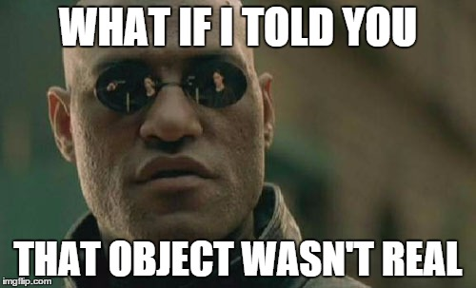
Delegates, Again
Mocking frameworks generally have helper methods that are delegate-based, for setting up mock/stub behavior.
As long as your SUT is using async Task and not async void, this is not a problem.
But some frameworks also have a default behavior, which may not be what you want.
Notes:
Why isn’t it a problem? Because mocking frameworks detect the return type (Task) and give you an appropriate delegate type.
It does not make sense to return a null task from an async method.
From the runtime’s perspective, that’s like calling a method and having the result be like “there was no method”.

Slide 26
Default Behavior
Good defaults (return a completed task):
Moq
FakeItEasy
NSubstitute
Bad defaults (return a null task):
MS Stubs
RhinoMocks

Slide 27
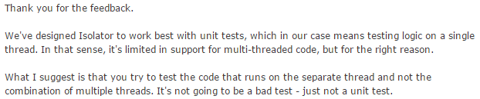
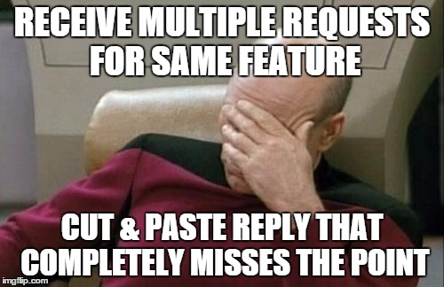
Dishonorable Mention: Typemock Isolator
Workaround:
AsyncContext.Run in my AsyncEx library.
Notes:
Typemock Isolator support posts this canned response to anyone asking for async unit test support.
Async, of course, is thread-agnostic. It does not really have anything to do with threading.
In summary: they won’t support async (a fundamental language feature), so I don’t recommend their product anymore.

Slide 28
Useful Methods for Mocking
Success:
Task.CompletedTask – 4.6
Task.FromResult<T>(result)
Exception:
Task.FromException(ex), Task.FromException<T>(ex) – 4.6
TaskCompletionSource<T>.SetException(ex) – 4.5
Cancellation:
Task.FromCanceled(ct), Task.FromCanceled<T>(ct) – 4.6
TaskCompletionSource<T>.SetCanceled() – 4.5

Slide 29
Demo: Async Mocks

Slide 30
Putting It All Together

Slide 31
A Quick Review
With async tests, we’re really just calling the system’s async method and then testing the task it returns.
Guidelines:
Avoid async void in your app. Seriously avoid it.
Don’t skip the Red part of the TDD cycle.
Use your own helpers if necessary for assertions.
Use your own helpers if necessary to fix stub defaults.
Notes:
Avoid async void: even for ICommand.Execute, only use a tiny async void method that just awaits its async Task equivalent. The async Task version is testable!
Don’t skip the Red: especially if you’re new to async unit tests.
Use helpers: Hopefully all assertion libraries will have better async testing in the near future.

Slide 32
Demo: Real-World (Almost)

Slide 33
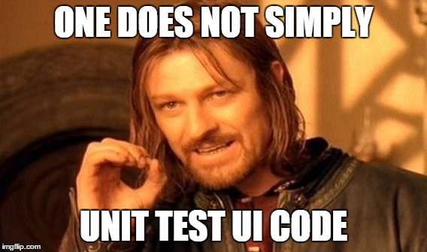
The First Advanced Topic
Notes:
It can be difficult to unit test ViewModels (logical UI), but often times unit testing VMs is not a high priority.
The real problem comes in when unit testing business logic that expects and synchronizes with a UI thread.
Business logic is critical to test, but it’s often tangled with UI types in legacy code.
We’ll now explore solutions to both of these problems (unit testing UI, and unit testing business logic that updates a UI).

Slide 34
Testing VMs Requires a Context
MSTest, Fixie – Never provide context (free-threaded).
xUnit – Always provides context (single-threaded context).
To leave a context, use Task.Run.
When you need a context:
A general solution: AsyncContext in AsyncEx.
Notes:
Bottom line: unit testing VMs or other UI-layer code is easiest if you use AsyncContext.

Slide 35
Business Logic Updating the UI
Correct approaches:
Use async/await to send results of an operation to the UI.
Use IProgress<T> to send progress updates to the UI.
Use Rx to send multiple data items to the UI.
Incorrect approaches:
Dispatcher.Invoke / Dispatcher.BeginInvoke (WPF)
Control.Invoke / Control.BeginInvoke (WinForms)
CoreDispatcher.RunAsync / CoreDispatcher.BeginInvoke (WinStore)
Notes:
There is NEVER a reason to use the methods in the lower half of this slide.
And there never has been.
(And I really avoid saying “never”).
Reasons:
Ties business logic to a specific UI framework.
Violates separation of concerns (why does business logic even know about a UI?)
The business logic is the most important code to test, and these approaches make this critical piece difficult to test.

Slide 36
Contexts: WPF
You shouldn’t be using Dispatcher.
But if you are…
Use WpfContext:
https://github.com/StephenCleary/AsyncCTPUtil

Slide 37
Contexts: WinForms
You shouldn’t be using Control.Invoke/BeginInvoke.
But if you are…
Use WindowsFormsContext:
https://github.com/StephenCleary/AsyncCTPUtil

Slide 38
Contexts: Windows Store
You shouldn’t be using CoreDispatcher.
But if you are…
There is a workaround (MSStoreHelp.ExecuteAsync):
Call CoreApplication.MainView.CoreWindow.Dispatcher.RunAsync.
Pass an async (void) method that captures execution into a TaskCompletionSource.
(Because UITestMethodAttribute does not support async)
Notes:
DEMO (optional)

Slide 39

The Second Advanced Topic
Notes:
TODO: update image

Slide 40
Rx TestScheduler
Timeout code generally uses:
CancellationTokenSource.CancelAfter
Task.Delay
Timers
Ideal: Replace with an abstraction, then have a test version.
The test version uses TaskScheduler.
Acceptable: Use MSFakes to redirect the original calls.
Notes:
DEMO (optional)

Slide 41
Q&A
Go forth and be awesome!
Notes:
Resources are available at StephenCleary.com - slides, example code, etc.

